Slide 1
University of Diyala. College of Engineering.
Department of Materials Eng.
3rd Year Polymers
Assist. Lecturer. Abbas Albawee. Lecture: 10. (2018/2019)
Polymer Recycling and Biodegradability.
During last decades, the great population increase worldwide together with the need of people to adopt improved conditions of living led to a dramatical increase of the consumption of polymers (mainly plastics). Tlie world‟s annual consumption of plastic materials lias inci‟eased from around 5 million tons in the 1950s to nearly 100 million tones today. Since tlie duration of life of plastic wastes is ver small roughl ٠/o liave duration of life smaller than one month), there is a vast waste stream that reaches eacli year to tlie final recipients creating a serious environmental pi‟oblem. Tlie presentl most common practice of liandling sucli waste streams is to incinerate tliem witli energy recovery or to use them for land- filling. Disposing of tlie waste to landfill is becoming undesirable due to legislation pressures (waste to landfill must be reduced by 35% over the period from 1995 to 2020), rising costs and the poor biodegradability of commonly used polymers. Tlierefore, recycling seems to be the best solution.
The recycling of waste polymers can be carried out in many wavs:
Primary recycling refei‟s to tlie „in-plant‟ rec cling of the scrap material of controlled history. This process remains the most popular as it ensures simplicity and low cost, dealing liowever only with the recycling of clean uncontaminated single-type waste.
Mechanical recycling (or secondary recycling). In tliis approach, the polymer is separated from its associated contaminants and i.t can be readily reprocessed into granules by conventional melt extrusion. Mechanical

Slide 2
University of Diyala. College of Engineering.
Department of Materials Eng.
3rd Year Polymers
Assist. Lecturer. Abbas Albawee.
Lecture: 10. (2018/2019)
recycling includes tlie sorting and separation of the wastes, size reduction

Slide 3
University of Diyala. College of Engineering.
Department of Materials Eng.
3rd Year Polymers
Assist. Lecturer. Abbas Albawee.
Lecture: 10. (2018/2019)
'"وYear, Plastic Engineering. Ass. Prof. Dr. Nabel Kadum.
and melt filtration. The basic polymer is not altered during the process. The main disadvantage of this type of recycling is the deterioratioir of product properties in every cycle. This occurs because the molecular weiglit of the recycled resin is reduced due to chain scission reactions caused by the presence of water and trace acidic, impurities. Strategies for maintaining the polymer average molecirlar weight during reprocessing include intensive drying, reprocessing with degassing vacrrrrm, tlie use of chain extender compounds, etc.
Chemical or Feedstock recycling (tertiary recycling) has been defined as the process leading in total depolymerization of PET to the monomers, or partial depolymerization to oligomers and other chemical substances. The monomers corrld subseqrrently repolymerized to regenerate the original polymer.
Energy recovery (Quaternary recycling) refers to the recovery of plastic‟s energ content. Incineration aiming at the recover of energy is currently the most effective way to reduce the volume of organic materials. Although polymers are actrrally high-yielding energy sources, this method has been widely accused as ecologically unacceptable owing to the health risk from air born toxic substances e.g. dioxins (in the case of chlorine containing polymers).
Tlie direct reuse of a plastic material (i.e. PET) could be considered as a “zero order” rec cling teclinique. In a lot of countries it is a common practice PET-bottles to refilled and reused. However, this should be done
with a great care since plastic bottles are more likely than glass to absorb contaminants that could be released back into food when the bottle is

Slide 4
University of Diyala. College of Engineering.
Department of Materials Eng.
3rd Year Polymers
Assist. Lecturer. Abbas Albawee.
Lecture: 10. (2018/2019)
refilled. Moreover, refill of a PET-bottle with a high-alcoholic-degree drink

Slide 5
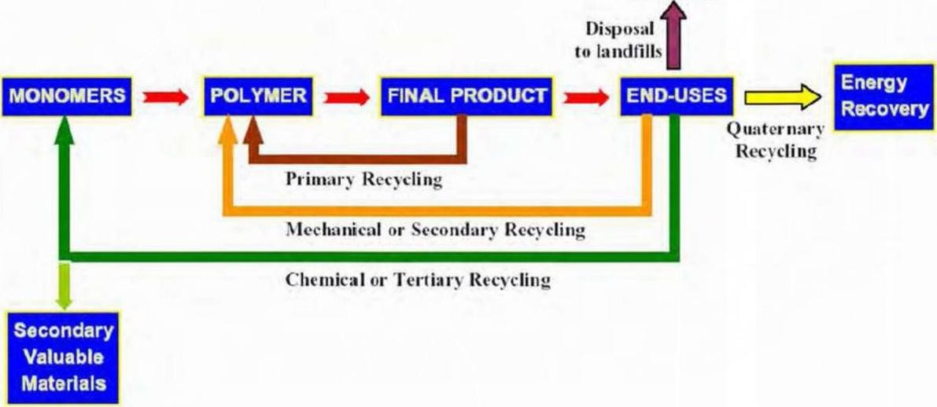
University of Al-Qadisiyah. College of Engineei’ing.
Department of Materials Eng.
₃rd
Year, Plastic
Engineering,
Ass. Prof. Dr. Nabel Kadum.
Lecture: 10. (2017/2018)
may lead to degradation of the macromolecular chains with unexpected results.
Polymer Recycling Techniques
The objective of a plastic management policy, in accordance with the principles of sustainable development (development that meets the needs of present generation without compromising the ability of future generations to meet their needs), should be not only the reuse of polymeric materials but also the production of raw materials (monomers), from which they corld be reproduced, or other secondary valuable products, which could be useful as feedstock for a variety of downstream industrial processes or as transportation fuel. In this sense, among the techniques proposed for recycling of waste polymers tlie most challenging method is chemical or feedstock recycling and various teclmologies have been successfully demonstrated and continue to be developed.

Slide 6
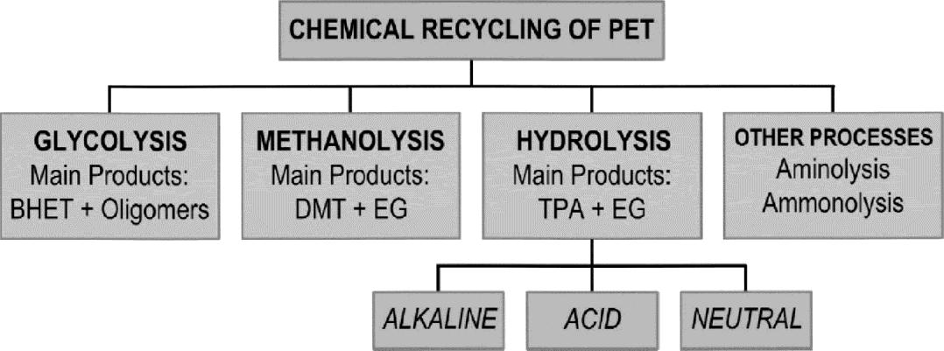
University of Al-Qadisiyah. College of Engineering.
Department of Materials Eng.
3ملا Year, Plastic Engineering. Ass. Prof. Dr. Nabel Kadum. Lecture: 1.0. (2017/2018)
Chemical recycling of poly(ethylene terephthalate) PET
PET is a polyester with functional ester groups that can be cleaved by some reagents, such as water (hydrolysis), alcohols (alcoholysis), acids
(acidolysis), glycols (glycolysis), and amines (aminolysis). Thus, chemical recycling processes for PET are divided as follows:
Hydrolysis,
Glycolysis,
Methanolysis and
other processes (Scheme 2). According to the reagent used different products are obtained.
The different process options for chemical recycling of PET waste may be categorized as follows:
(i) regeneration of base monomers (methanolysis for dimethyl terephthalate (DMT) and hydrolysis for producing pure Terephthalic acid (TPA) and ethylene glycol (EG))؛
(ii)
(iii)
(iv)
(v)
conversion into oligomers (glycolysis or solvolysis)؛ use of glycolyzed waste for value-added products؛
conversion into speciality chemicals by aminolysis or ammonolysis؛ conversion into speciality intermediates for use in plastics and
coatings.
Chemical recycling techniques of PET

Slide 7
University of Al-Qadisiyah. College of Engineering.
Department of Materials Eng.
3ملا Year, Plastic Engineering. Ass. Prof. Dr. Nabel Kadum. Lecture: 1.0. (2017/2018)
Chemical recycling of polystyrene
Polystyrene (PS) is widely used in the manufacture of many products due to its favorable properties such as good strength, light weight, and
durability and is tlie material of choice for packaging various electronics and other fragile items. In general accounts for about - ٠/o of the plastic waste in municipal solid waste .
In the past several years, PS has received much public and media attention.
Polystyrene has been described by various environmental groups as being nondegradable, nonrecyclable, toxic when burned, landfillchoking, ozone- depleting, wildlife-killing, and even carcinogenic. These misconceptions regarding PS have resulted in boycotts and bans in various localities.
ctuall comprises less than . ٥/o of the solid waste going to landfills.
Polystyrene is used in solid and expanded forms both of which can be recycled. Solid PS components such as coffee cups, trays, etc. can be recycled back into alternative applications such as videocassette cases, office equipments, etc. Expanded PS (EPS) foam waste loses its foam characteristics as part of the recovery process. The recovered material can be re-gassed but the product becomes more expensive than virgin material. Instead it is used in solid form in standard molding applications. Both expanded and solid PS wastes have been successfully recycled in extmded plastic timber-lumber. Rec cled is used to pr‟oduce plant pots and desk items sucli as pen, pencils, etc. As with other types of plastic materials, PS recycling takes place after consideration by the industry of a number of issues including eco-efficiency, availability, corporate social responsibility, product qualitylygiene aspects, and traceability.

Slide 8
University of Al-Qadisiyah. College of Engineering.
Department of Materials Eng.
3ملا Year, Plastic Engineering. Ass. Prof. Dr. Nabel Kadum. Lecture: 1.0. (2017/2018)
Chemical recycling of polyethylene (LDPE and HDPE)
Under the category of chemical recycling of polyethylenes, advanced process (similar to those employed in the petrochemical industry) appear
e.g. pyrolysis, gasification, liquid-gas hydrogenation, viscosity breaking, steam or catalytic cracking. Catalytic cracking and reforming facilitate the selective degradation of waste plastics. Tlie use of solid catalysts such as
silica alumina, ZSM-5, zeolites, and mesoporous materials for these
purposes has been reported. These materials effectively convert polyolefins into liquid fiiel, giving lighter fiactions as compared to thermal cracking.
In particular, polyethylene has been targeted as a potential feedstock for fiiel (gasoline) prodrrcing technologies. PE thermally cracks into gases, liquids, waxes, aromatics and char. The relative amormts of gas and liquid
fiaction are very much dependent on the type of polymer used. Thus, liiglier decomposition was observed in pp, followed by LDPE and finally HDPE. It seems that less crystalline or more branched polymers are less stable in thermal degradation.
Chemical recycling of poly(vinyl chloride)
Poly(vinyl chloride) main applications include food packaging, shoes, flooring ,pipes, clothing (leather-like material), ceiling tiles and multi-layered flooring and windowswindoors frames. It has a lifetime range
of 5 years. PVC has the same density as that of PET, a property tliat made the separation prior to recycling of plastic wastes containing both polymers really difficult. The technique used for the efficient separation is x-ray fluorescence. The chlorine atoms of PVC are detected and tlie wastes are
indicated for separation.

Slide 9
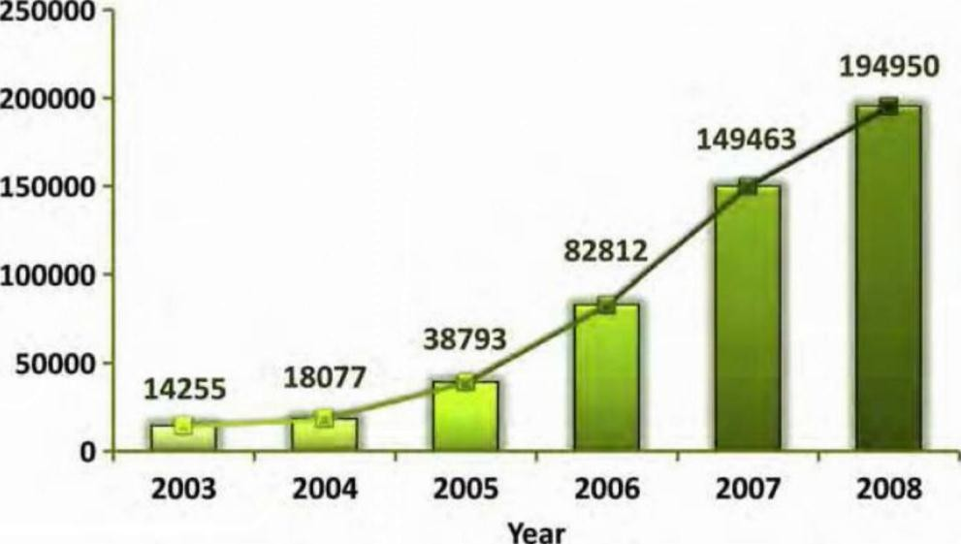
University of Al-Qadisiyah. College of Engineering.
Department of Materials Eng.
3ملا Year, Plastic Engineering. Ass. Prof. Dr. Nabel Kadum. Lecture: 1.0. (2017/2018)
In principle, PVC waste can be available in two ways: as a mixed plastic waste (MPW) fraction (with a rather low PVC content), or as a PVC-rich plastics fraction.
Recycled PVC in EUROPE
Chemical recycling of nylon
Nylon is one of the early polymers developed by Wallace Carotliers in 1935, at DuPont's research facility. Today, nylon is one of tlie most commonly used polymers. Nylons, also known as polyamides, can be produced by the reaction of a diamine with a dicarboxylic acid,
condensation of the appropriate amino acid, ring opening of a lactam, reaction of a diamine with a diacid chloride, and reaction of a diisocyanate
with a dicarboxylic acid. Nylon is a crystalline polymer with high modulus, strength, impact properties, low coefficient of fiiction, and resistance to abrasion. A variety of commercial nylons are available including nylon 6,
nylon 11, nylon 12, nylon 6,6, nylon 6,10, and nylon 6,12. The most widely used nylons are nylon 6,6 and nylon 6. Polyamides are used most often in the form of fibers, primarily nylon 6,6 and nylon 6, although engineering

Slide 10
University of Al-Qadisiyah. College of Engineering.
Department of Materials Eng.
3ملا Year, Plastic Engineering. Ass. Prof. Dr. Nabel Kadum. Lecture: 1.0. (2017/2018)
applications are also of importance. Nylon 6,6 is prepared from the polymerization of adipic acid and hexamethylenediamine, while nylon 6 is prepared from caprolactam.
Processing of recyclables is necessary to transform the collected materials into raw materials for the manufacture of new products. In general there are two categories for nylon recyclingchemical and thermal recycling.
٠ Cliemical recycling. Involves breaking down the molecular structure of tlie pol mer using chemical reactions. The pi‟oducts of tlie reaction then can be purified and used again to produce either the same or a related polymer.
٠ Thermal recycling. Also involves breaking down the chemical structure of
the polymer. In this case, instead of relying on cliemical reactions, the primary veliicle for reaction is heat. In pyrolysis, for example, tlie polymer (or mixture of polymers) is subjected to liigli lieat in the absence of sufficient oxygen for combustion. At tliese elevated temperatures, the polymeric structure breaks down.

